Slide 1


Let’s Trade
-invest to grow money
-TRADING APPLICATION

Slide 2
Console based Trading Application
Team Members.
-Harshith
-Mohan
-Rohan
-Ravi Teja
-Vishnu

Slide 3
Console based Trading Application(working)
Objectives
With the help of Demat and Trading account, buying and selling of shares has become a much faster and even process than trading with the assistance of a physical broker. It provides for the assimilation of bank, broker, stock exchange and depository participants.

Slide 4
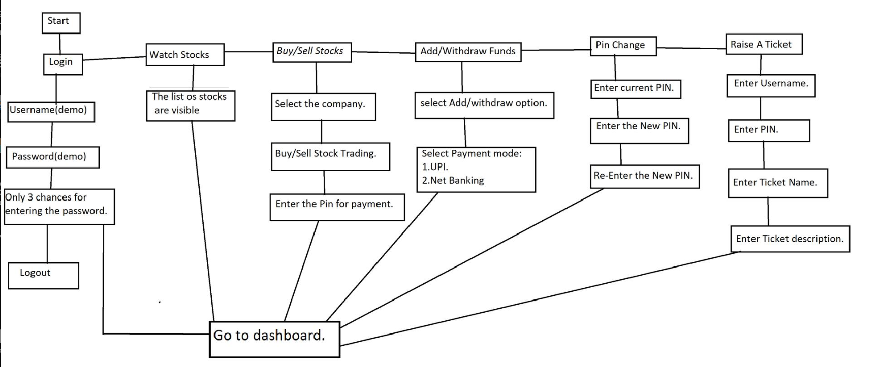
Work Flow:

Slide 5
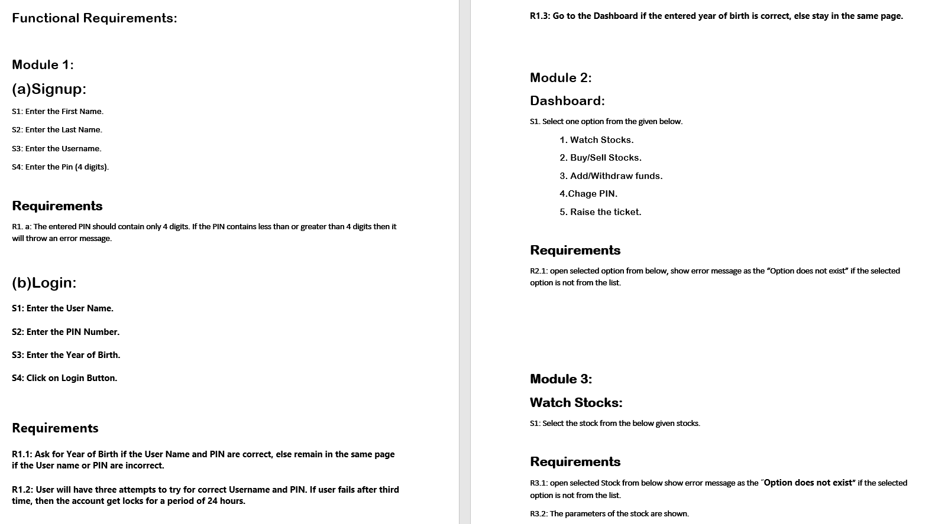
SOFTWARE REQUIREMENT SPECIFICATION

Slide 6
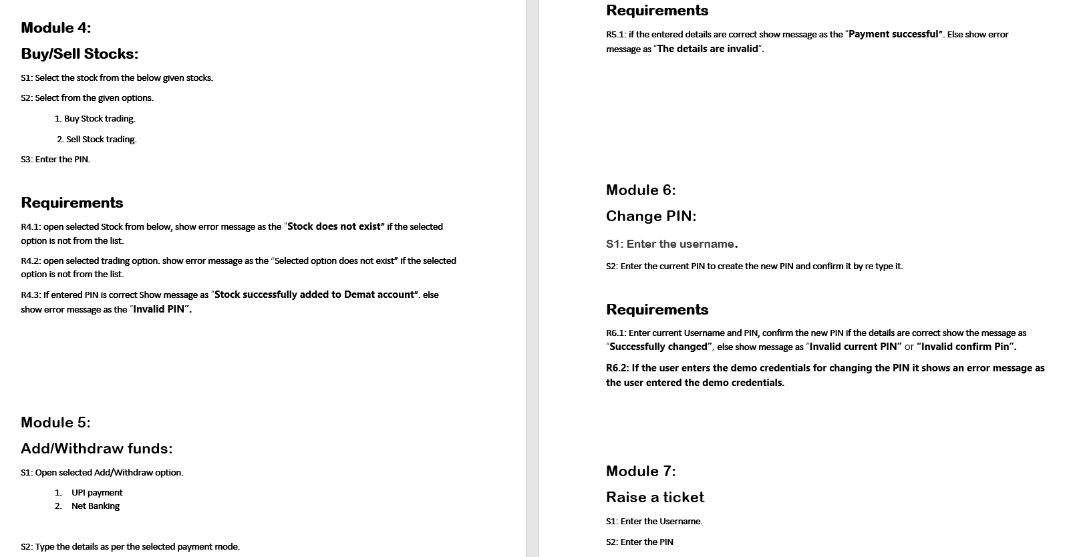

Click here:

Slide 7
The Source Code Includes the Following Classes.
Mainclass.java
Login.java
Dashboard.java
watchStocks.java
BuyOrSellStock.java
Addwithdrawfunds.java
PinChange.java
RaiseTicket.java
BackLogOut.java
DBConnection.java
CheckUser.java
Update.java

Slide 8
Mainclass.java
This is the main class that should be to run the program.
This class is used to invoke the basic login class which contains the login functionalities where the user has to enter demo login credentials.

Slide 9
Login.java
- The user has to enter the login credentials to login the page.
- Username – Admin.
- PIN – 1234.
- Year of birth should be greater than 18 years or else the user will not able to login the page.
- If the user enters wrong credentials more than 3 times than application will terminate automatically.
-If the login credentials are valid then the user is able to enter into the dashboard.

Slide 10
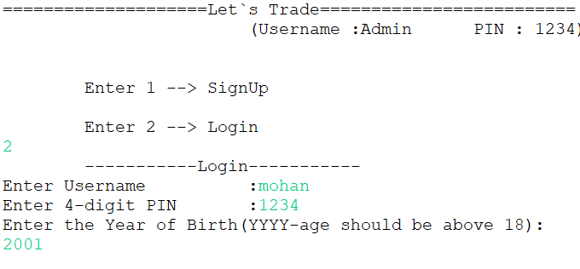
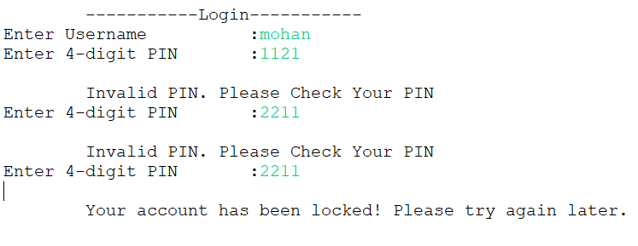
When User enters valid details
When User enters Invalid details

Slide 11
Dashboard.java
After we enter the dashboard, user is able to select the visible options.
(1).Watch Stocks.
(2).Buy/Sell Stocks.
(3).Add/Withdraw funds.
(4).Change PIN.
(5).Raise the ticket.
Enter any key to logout.

Slide 12
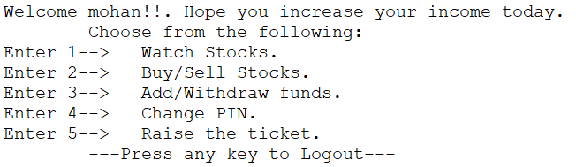
After Entering Valid details the dashboard is displayed.

Slide 13
WatchStocks.java
By entering key 1 in the dashboard user is able to watch stocks from the below 5 visible companies.
(1) Hcl Technologies Limited.
(2) Burger King India Ltd.
(3) Kotak Mahindra Bank Limited.
(4)Tata Consultancy Services Limited.
(5) Hdfc Bank Limited.

Slide 14
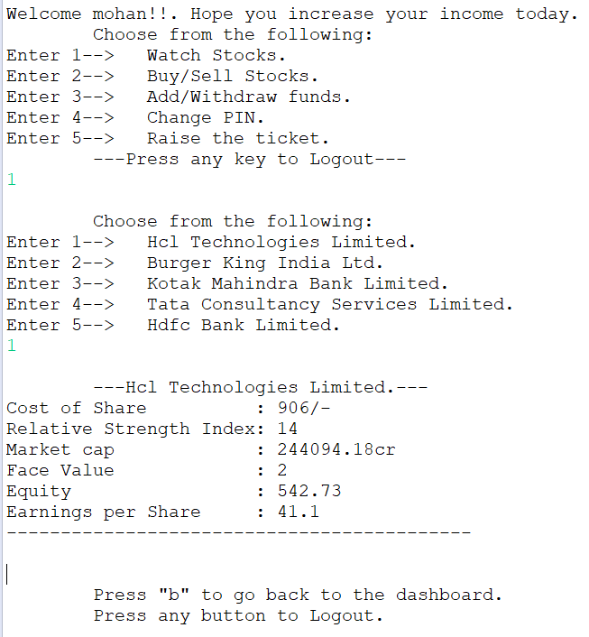
After Opening Watch Stocks

Slide 15
BuyOrSellStock.java
By entering key 2 in the dashboard user is able to BuyOrSellStock from the available shares.
After selecting the shares the below 2 options will be displayed.
(1) Buy stock trading
(2) Sell stock trading

Slide 16
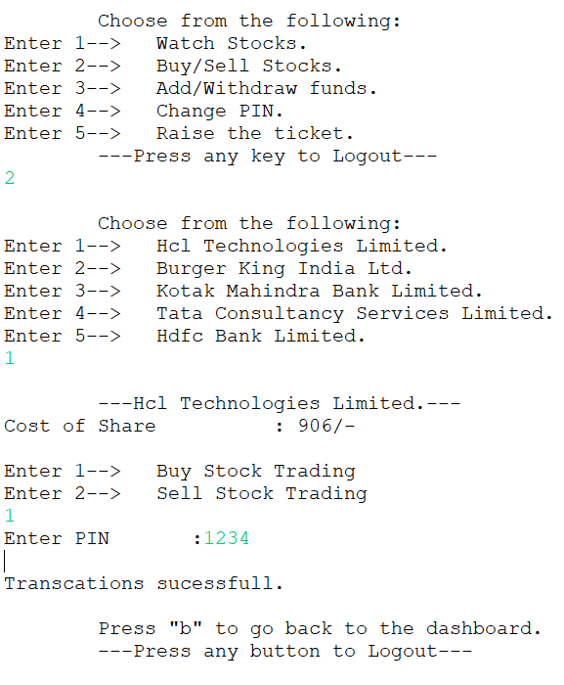
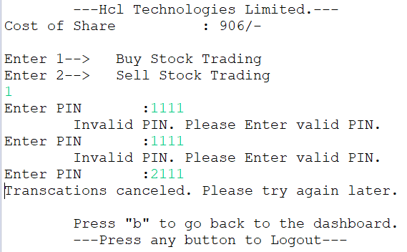
Entering Valid and Invalid details

Slide 17
AddWithDrawFunds.java
By entering key 3 in the dashboard user is able to Add or withdraw funds.
(1) Add funds
(2) Withdraw funds
After selecting from the above options the user has to enter the related details.
If the user enters the wrong option the error message will be displayed as “Invalid input. Try again”.

Slide 18
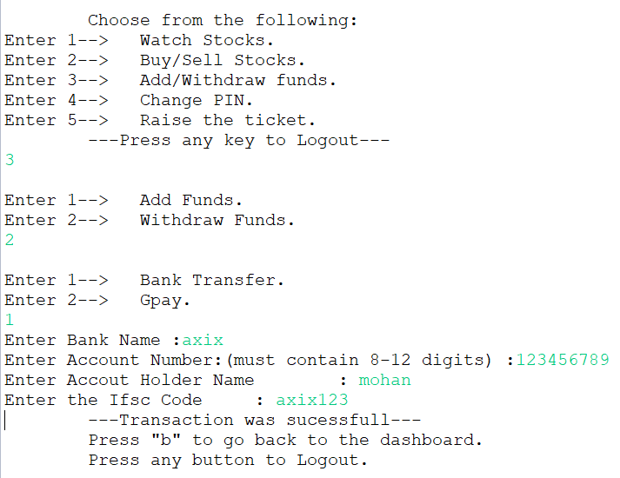
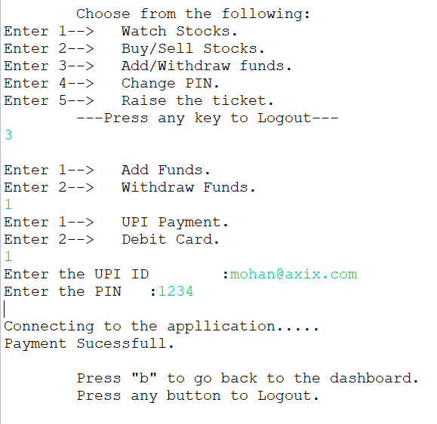
Adding and Withdrawing Funds

Slide 19
PinChange.java
By entering key 4 in the dashboard user is able to change the pin which is already given as demo.
The changed pin is used for the other functionalities as Add or With Draw funds etc.

Slide 20
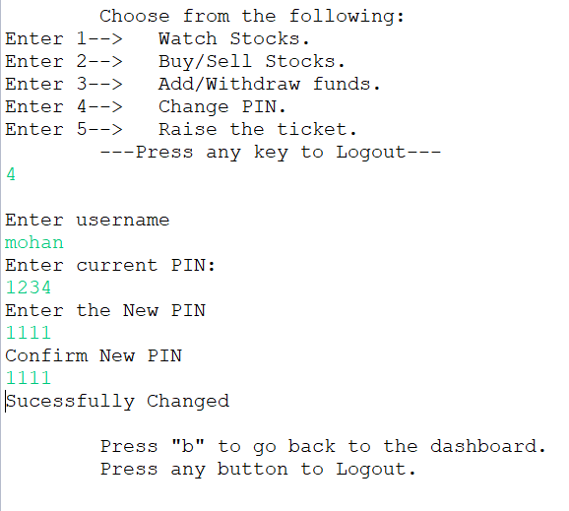
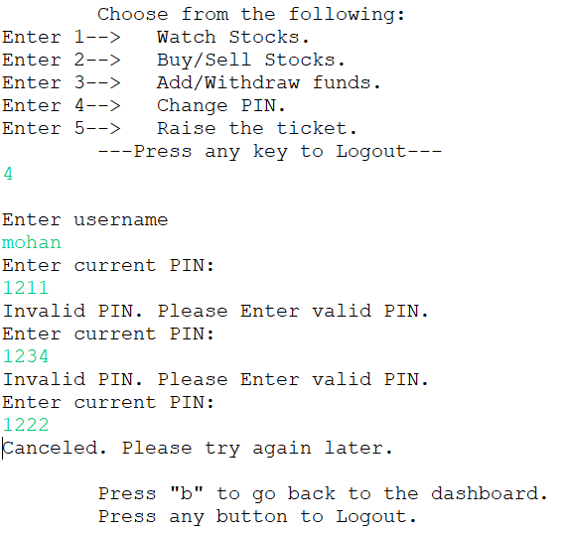
Changing PIN

Slide 21
RaiseTicket.java
By entering key 5 in the dashboard user is able to Raise the ticket.
It helps the users to solve their queries by raising a ticket.
To raise a ticket the user has to enter the below valid details.
Enter the Username.
Enter the PIN
Enter the Ticket name
Enter the Ticket description

Slide 22
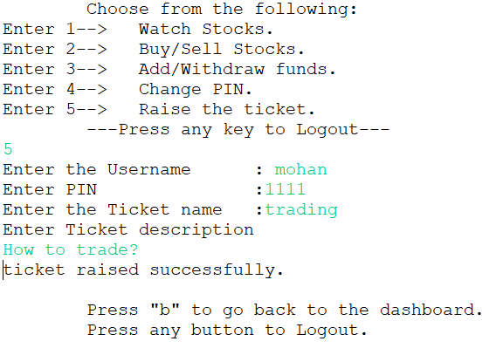
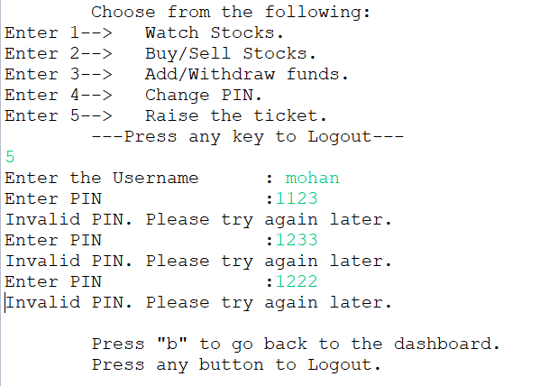
Raise a Ticket

Slide 23
BackLogOut.java
- This class is executed in each and every functionalities of the dashboard for going back to dashboard or logout.
The user has to enter “b” to return to dashboard.
The user has to enter any key to get logout.

Slide 24
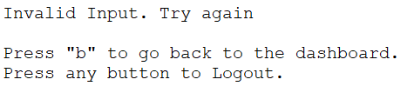
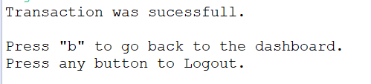
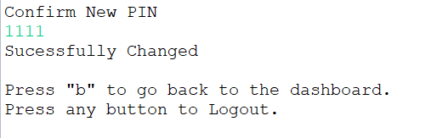
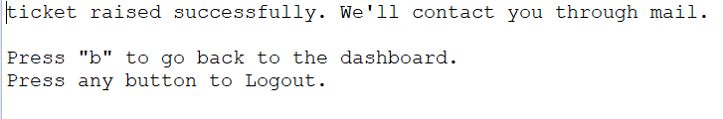
After every functionality it ask user whether go back to dashboard or to Logout

Slide 25
DBConnection.java & CheckUser.java
DBConnection class is used for establishing the database connection for the log in functionality.
CheckUser class is used to check whether the entered details and database details are same or not.

Slide 26
Update.java
This class contains two methods, signup and update PIN where the user can save his credentials.
Next method update PIN where if user wanted change the PIN he can update his new PIN with this method.

Slide 27
Concepts Implemented in program
- > Classes & Objects.
-> Inheritance.
-> Exception Handling
-> JDBC

Slide 28
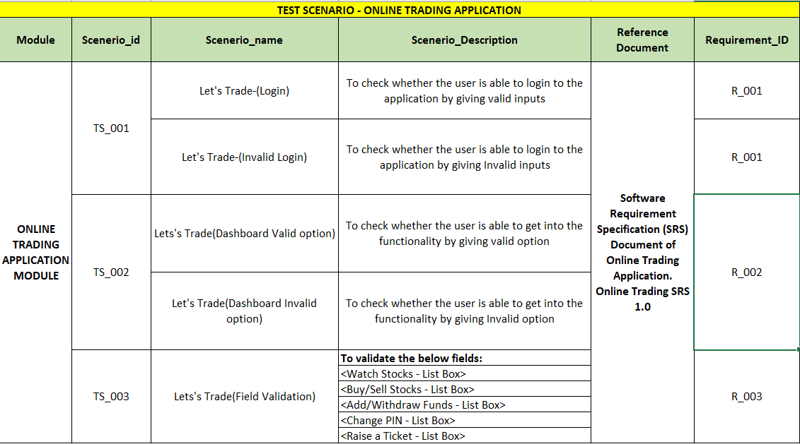

Testing Deliverables
Click here:

Slide 29
Swag Labs Demo E-commerce Application
Testing of swag labs demo e-commerce application

Slide 30
Swag Labs E-commerce Web Application
Swag labs is an online demo site for e-commerce which is made by sauce labs.
It contain clothes, backpack, bike accessory where customer can purchase through online.
To login into the website there is a demo login id and password.
This demo site contains “login”, “logout”, “add to cart”, “ordering”.

Slide 31
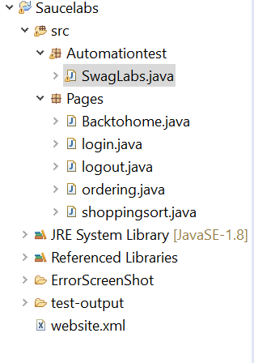
Automation Testing Classes
CLASSES

Slide 32
Dependencies Used in Program
TestNg: TestNG enables you to group the test cases easily which is not possible in JUnit. TestNG supports three additional levels such as @Before/After suite, @Before/After Test, and Before/After Group.
org.seleniumhq.selenium: used for handling WebDriver, drivers for chrome, web elements, find by.
Extent Report is an open-source reporting library used to create visually attractive reports for Selenium tests using JUnit and TestNG. Extent reports produce HTML-based documents that offer several advantages like pie charts, graphs.

Slide 33
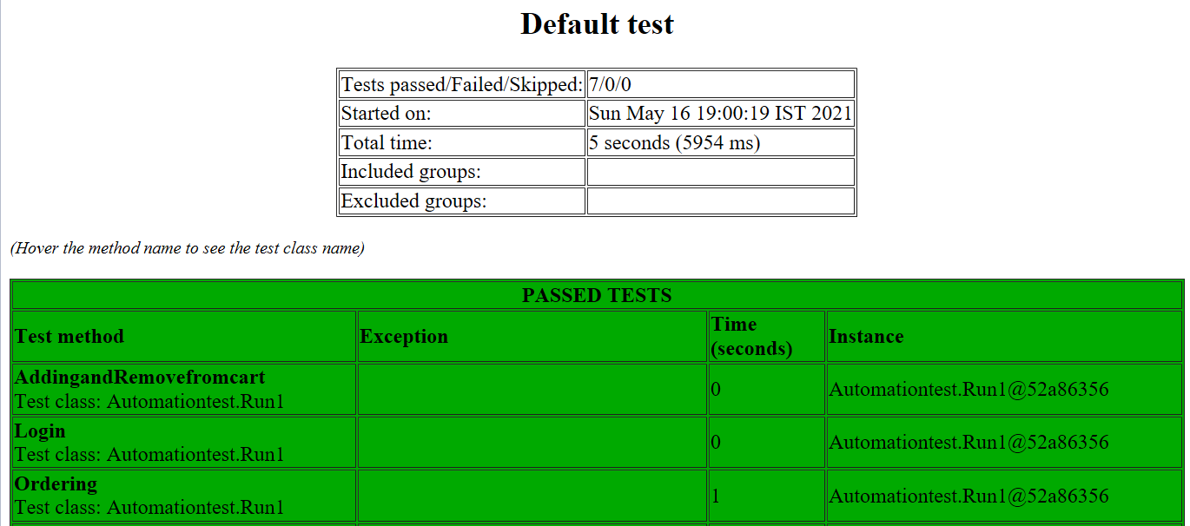
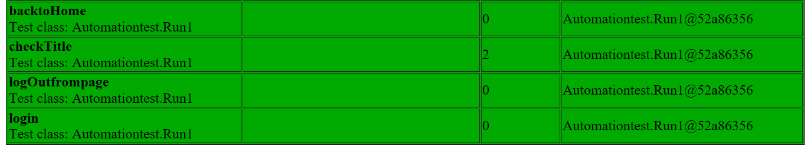
Testing Output

Slide 34
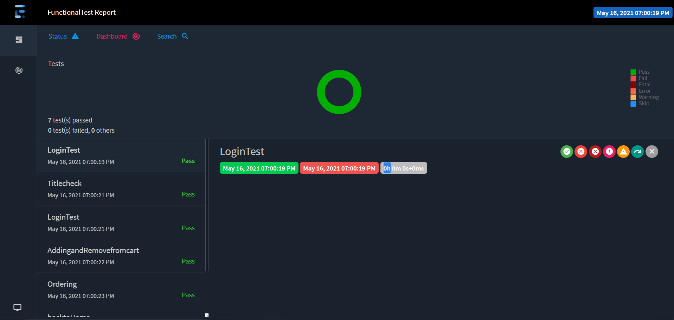
Extent Report

Slide 35
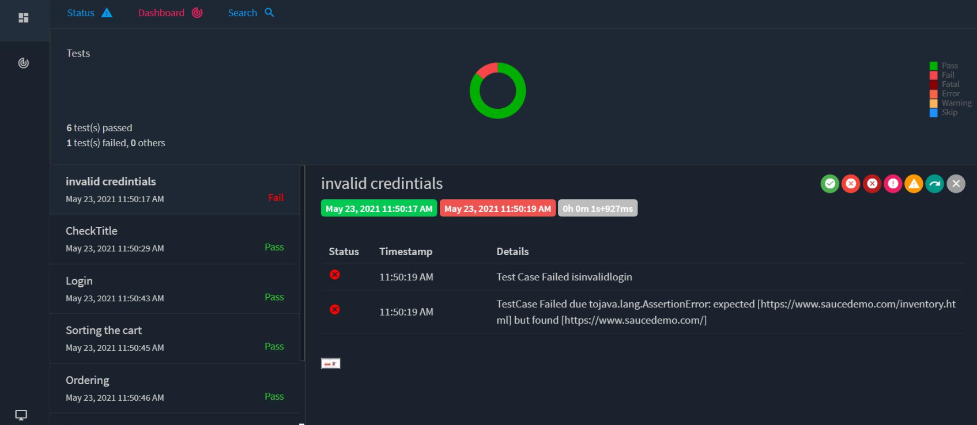
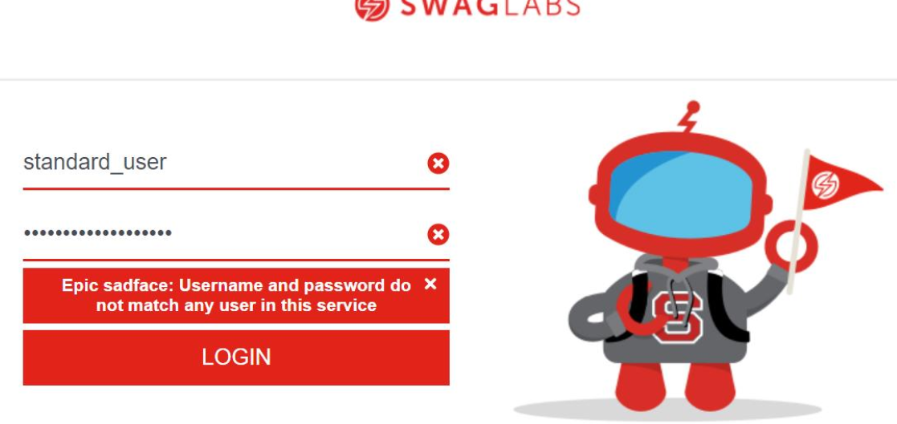

Slide 36

Thank You

